Slide 1




LMDCZ-AFD project:
Regional 3D CROCO simulations
LMDCZ workshop, 12-14 April 2017 Ho Chi Minh City, Vietnam
Patrick Marchesiello
IRD, CARE Lab,
HCMC University of Technology

Slide 2
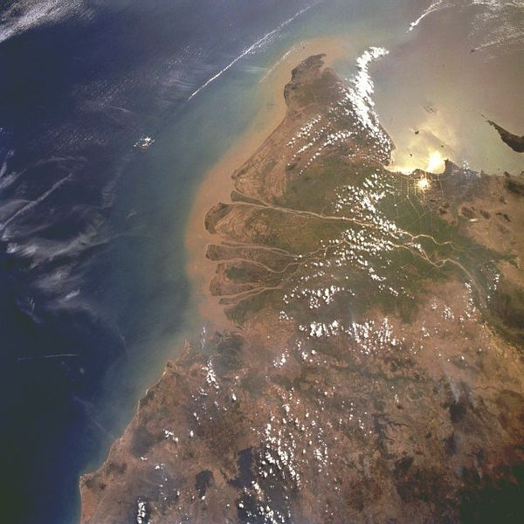
Coastal ocean forcing is complex:
waves, tides, wind and density driven currents
Tidal range and currents larger on East coast (3.5 m) than West coast (1m).
Same for waves
River discharge
Winter winds and waves
Tidal and
frontal currents
Summer winds and waves

Slide 3
Shelf and nearshore processes
Nearshore (1km)
Innershelf (10km)
River input
Transport
Delta front
Resuspension
Deposition
Mobile mud belt

Slide 4

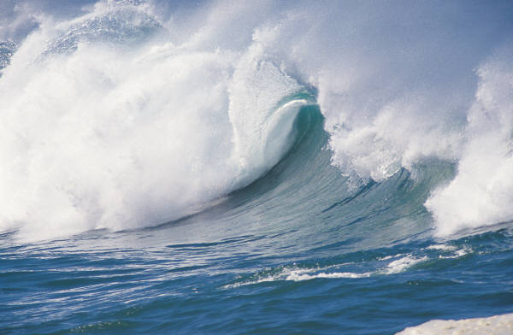


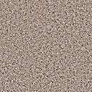
Ocean modeling systems
ATMOSPHERE
WAVES
Hs, T, Dir
OCEAN CIRCULATION
Wave-averaged
U,V, Tracers equations
BOTTOM LAYER
Bottom stress due to waves and currents
DATA
WAVES
Boundary forcing and breaking parameters
SEDIMENTS
Sediment and bed properties
SEDIMENT model
Deposition, erosion, suspended and bedload transport, bed evolution

Slide 5
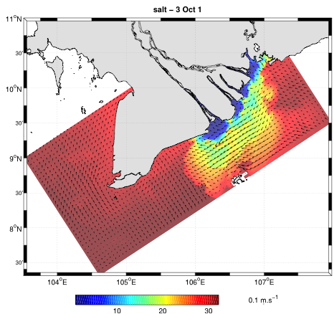
CROCO: a community 3D coastal modeling system based on ROMS
Full 3D model with active and passive tracers
Wave-current interactions
Sediment model (cohesive and non-cohesive)
Optimized for parallel computers and high resolution problems

Slide 6
Configuration

Slide 7
Configuration
Domain size |  | Covers whole LMDCZ system
Horizontal resolution |  | 500 m (374x727pts)
Vertical resolution |  | 10 levels (terrain following)
Topography |  | SIWRR data (estuaries, nearshore area) + GEBCO_2014 at 30” (1km)
River forcing |  | Discharge and SSC at Can Tho and My Thuan from SIWRR station data
Tidal forcing | U,V, SSH | OSU TPXO8 global solution at 1/30° (~3 km)
Subtidal forcing | U,V, SSH, T, S, SSC | ECCO V2 reanalysis ¼° 3-daily
Air-sea forcing | wind, heat and freshwater fluxes | ECMWF ERA-Interim 1979-2016 at ¼° 6-hourly
Wave forcing | Hs, Dir, Tp | ECMWF ERA-Interim 1979-2016 at ¼° 6-hourly
Sediment parameters | D50, Ws | Sand: d50=200 microns; Ws=20-50 mm/s Mud (Flocculi): d50=20 microns; Ws=0.03 mm/s

Slide 8
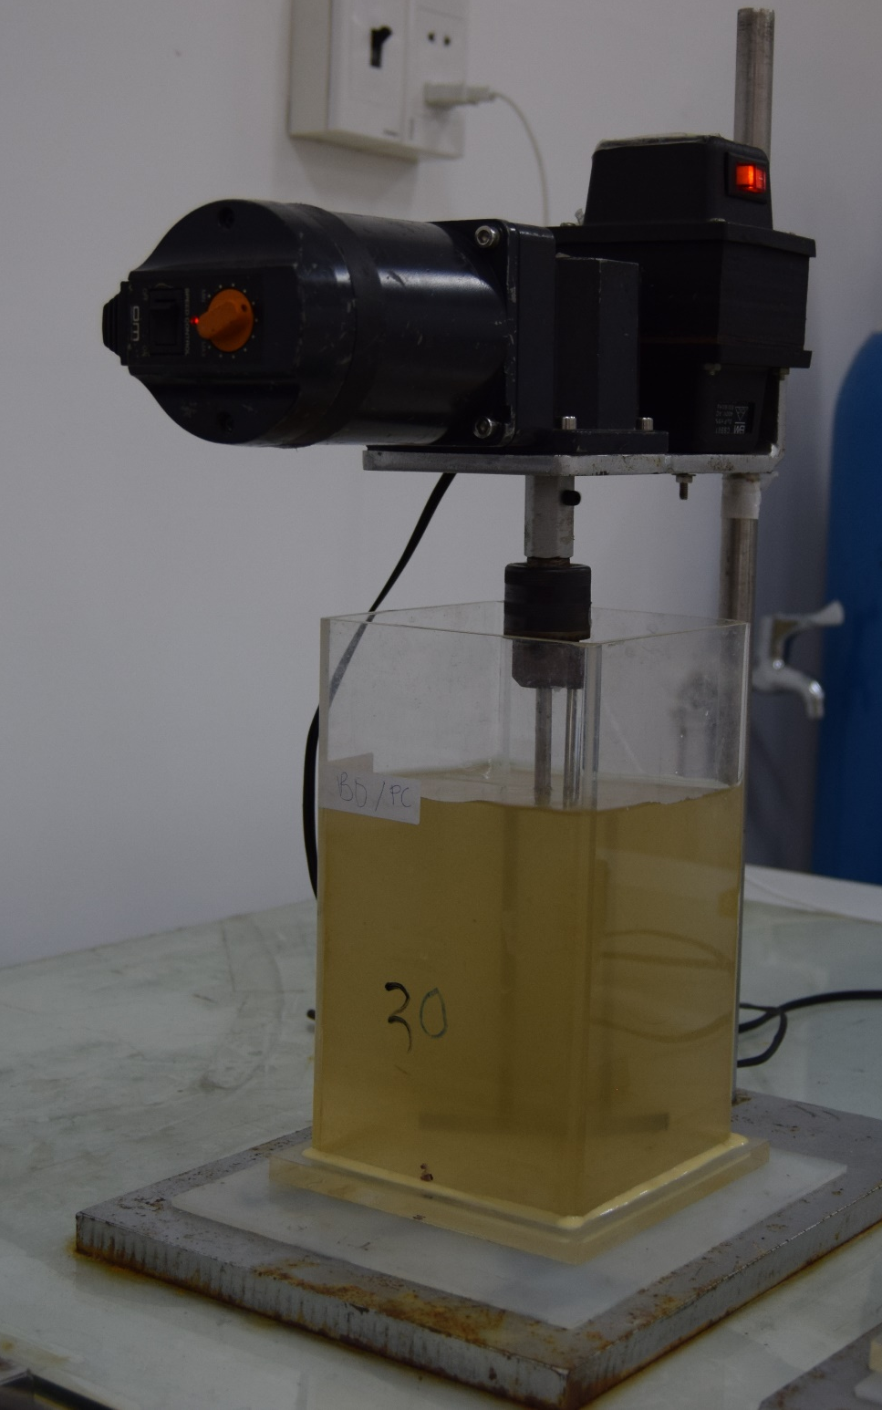
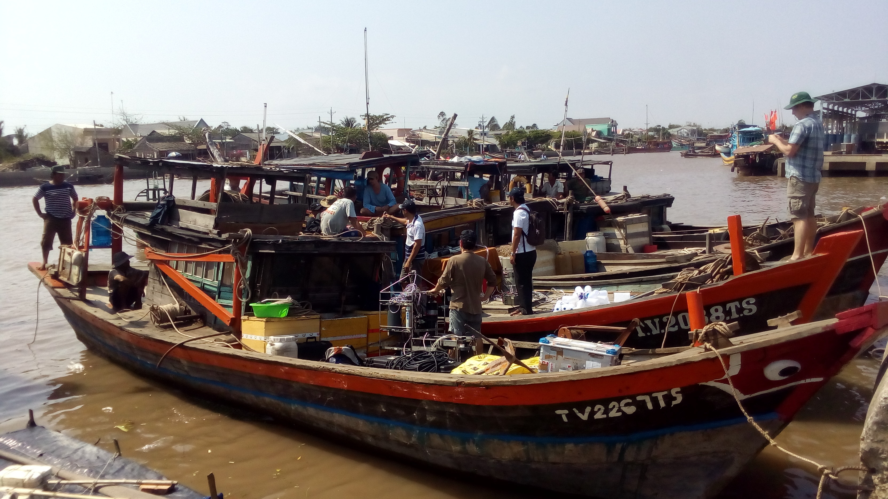
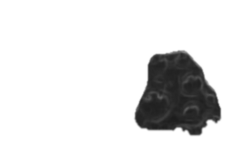
Sediment characteristics (N. Gratiot)
Clay
Flocculi
Floc
Sand
For SSC<200mg/l, sediments in LMDCZ can be modeled using 2 types:
Sand
  D50=200 microns
  Ws=20-50 mm/s
Mud (Flocculi)
  D50=20 microns
  Ws=0.03 mm/s
→ Erosion parameter and critical shear stress from calibration with satellite data

Slide 9
Circulation in the ROFI of LMDCZ

Slide 10
TIDES satellite altimetry data
Joint TOPEX, Jason 1 and Jason 2 tracks of primary mission (green lines) and interleaved mission (black lines) in the Vietnam East Sea (Nguyen et al., 2013)
CTOH group, LEGOS Lab, Toulouse

Slide 11
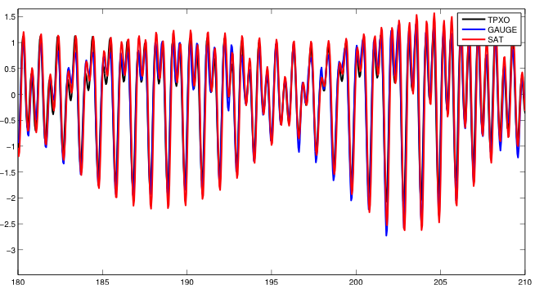
Validation with tidal gauges and satellite data
VUNG TAU – July 2009

Slide 12
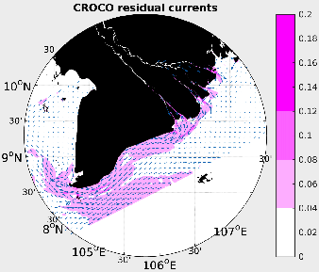
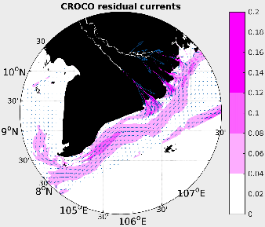
Mean currents
January 2014
October 2014

Slide 13
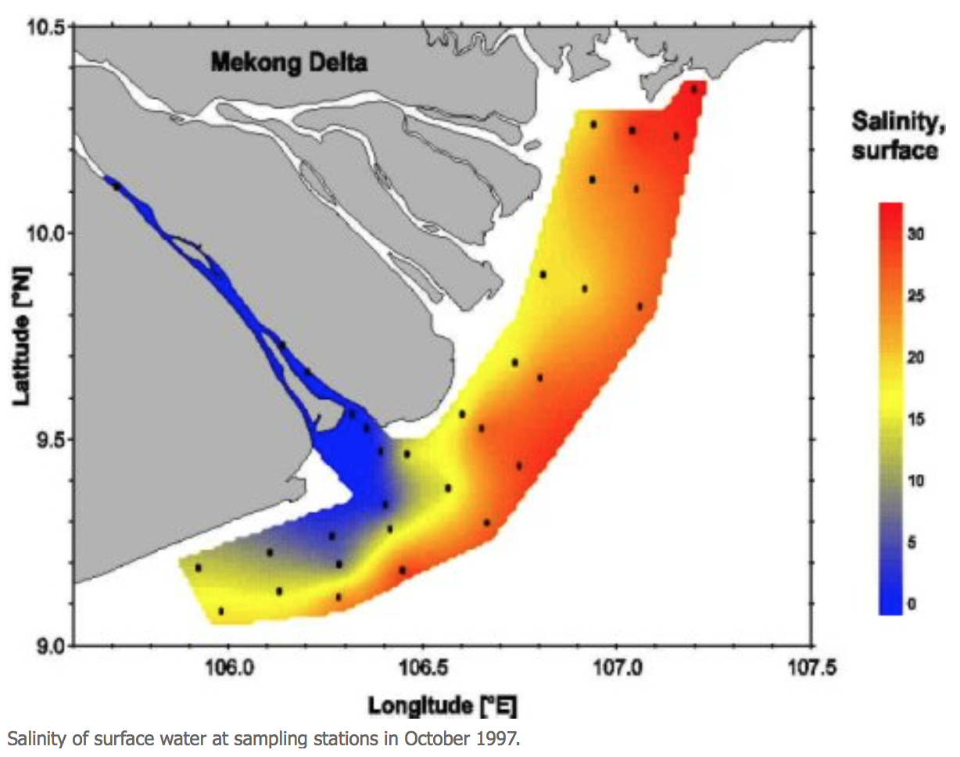
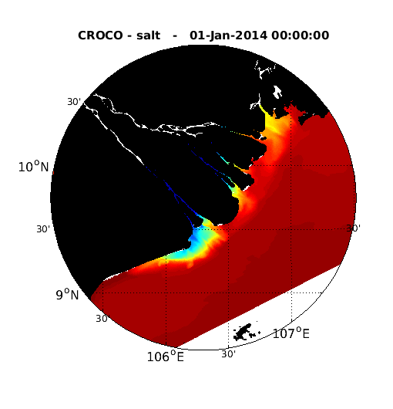
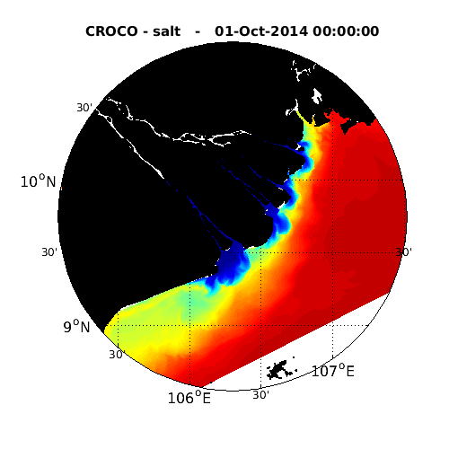
Salinity
Easily observed and a good tracer of the flow

Slide 14
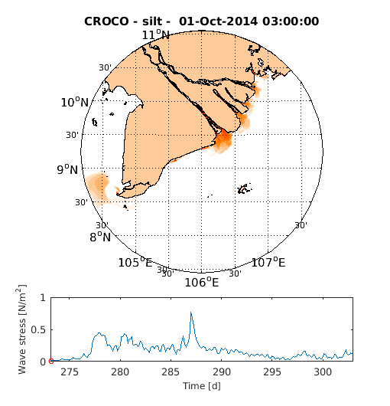
Sediment resuspension due to waves

Slide 15
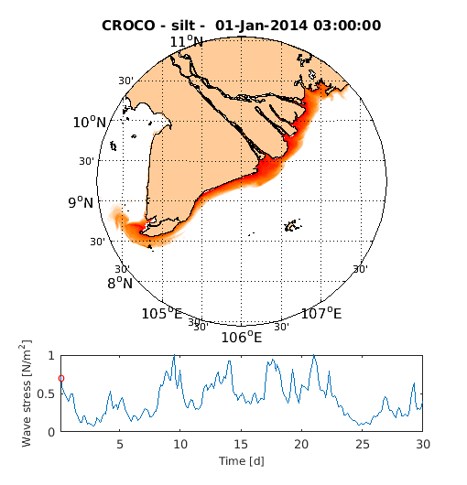
Sediment resuspension due to waves

Slide 16
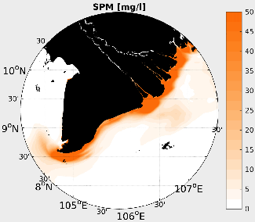
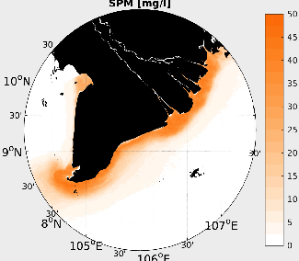
SSC
MODEL
SAT DATA
January
October
January

Slide 17
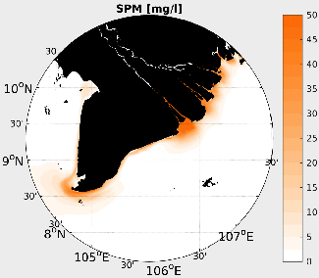

SSC
MODEL
2002-2012 DATA
January
October
January
October

Slide 18
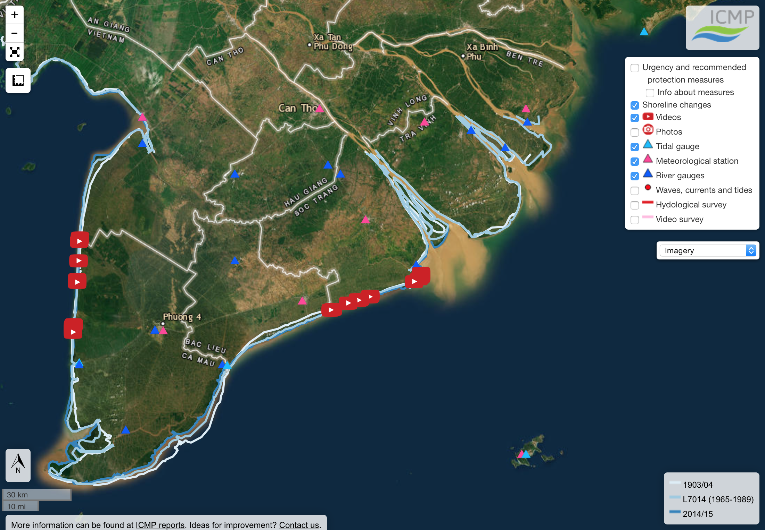
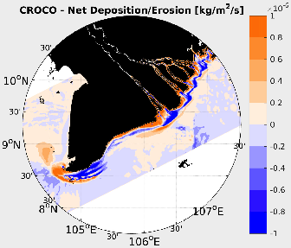
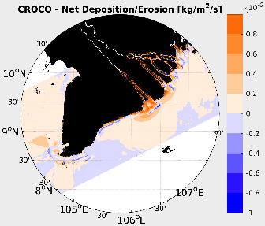
Model erosion
summer
winter

Slide 19
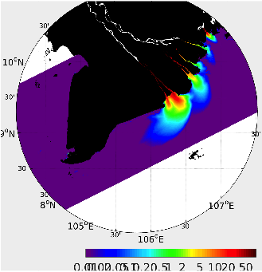
Sensitivity to river sediment concentration
River sediment concentration decreased from 200 to 50 g/l
SSC Difference

Slide 20
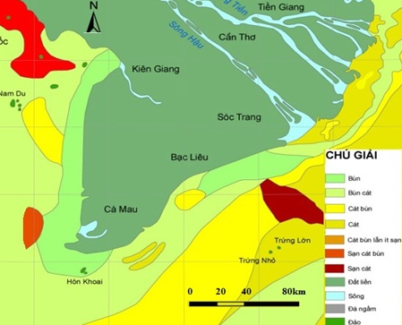
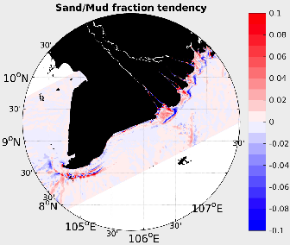
Sand/Mud fraction tendency
VAST

Slide 21
CONCLUSIONS
Setup of regional 3D CROCO model done
  Regional oceanic forcing benefits from Hoi-An project and is suitable
  Calibration of sediment models is suitable, using the project’s field surveys and previous observations as well as satellite data
3D modeling includes missing processes in 2D models:
  Salinity fronts and stratification effects
  Cross-shore processes
Sorting out coastal processes will be key to select the right protection measures

