Slide 1
PROJECT: STUDY ON THE EROSION PROCESS AND THE MEASURES FOR PROTECTING THE LOWER MEKONG DELTA COASTAL ZONES FROM EROSION
INSTALLING CAMERA SYSTEM FOR MONITORING ON MORPHOLOGICAL CHANGES OF THE LMDCZ
Presenter: Nguyen Minh Trung

Slide 2
OBJECTIVES
The monitoring on morphological changes of the LMDCZ and on the wave propagation will be done with the help of camera technique.
TASKS
Survey field conditions at Ca Mau and Tien Giang Provinces for camera installation
Select characteristic of camera and design configuration of stations
Prepare bidding documents
Select contractors
Construction and equipment installation
Training on camera image analysis technique

Slide 3
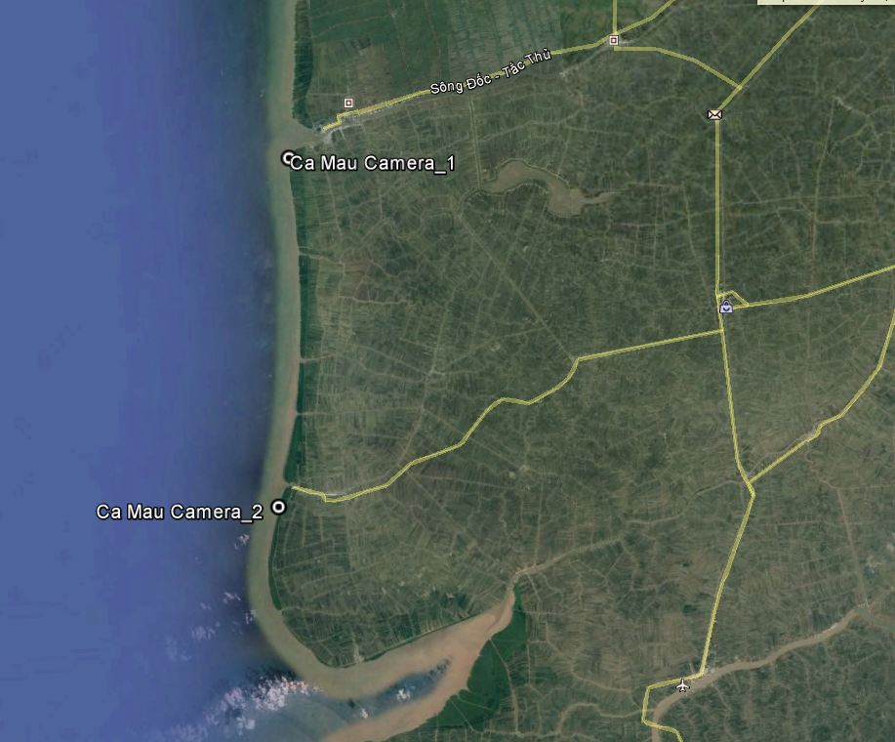
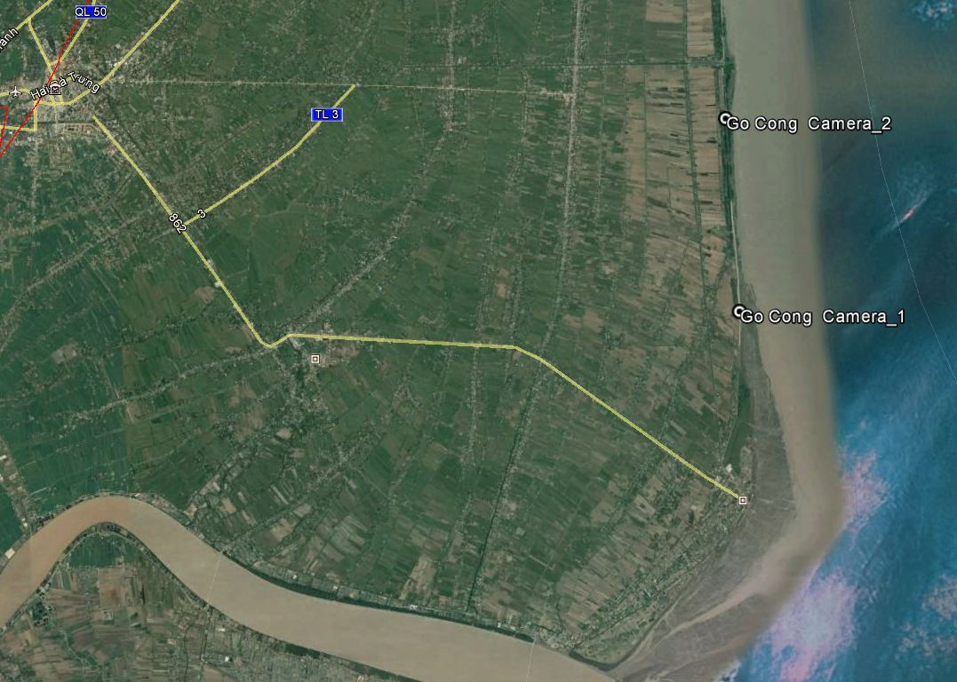
FIELD SURVEY
2 times: visited on the field to Tien Giang and Ca Mau (8-9 Sept, 2016 and 2-3 March, 2017)

Slide 4
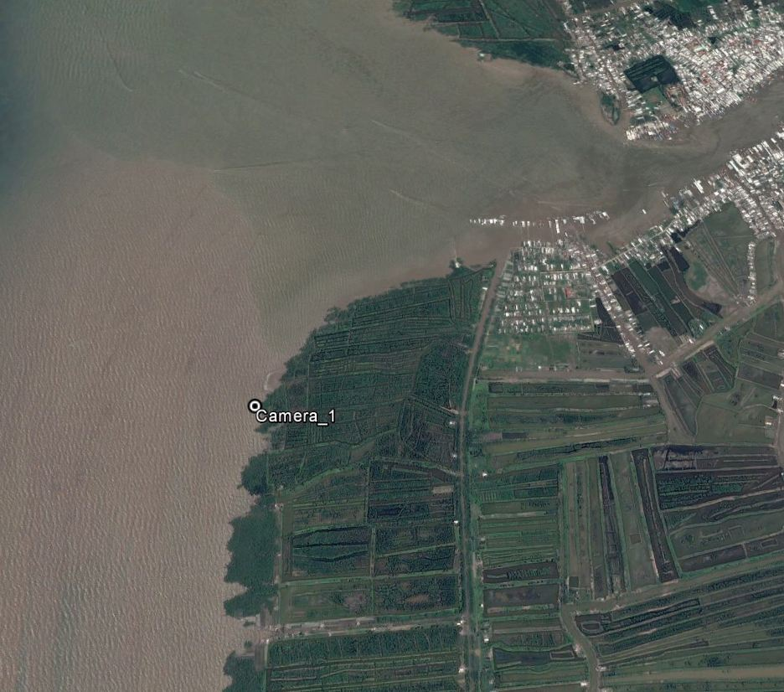
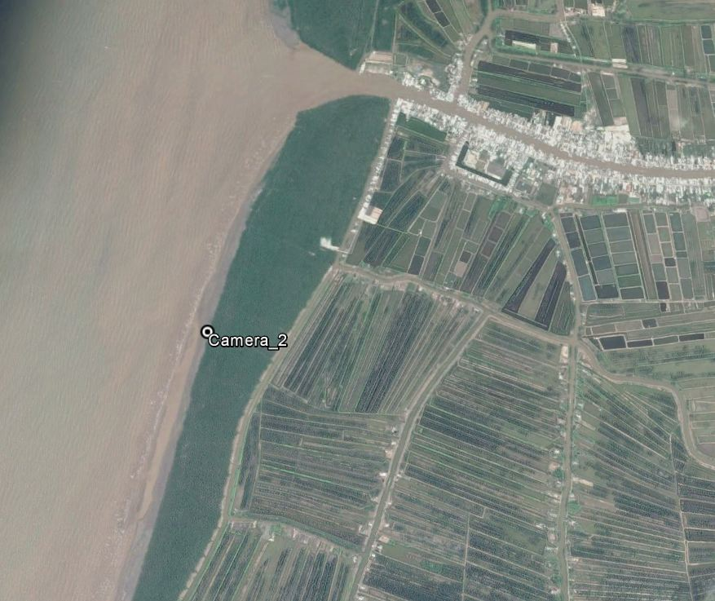
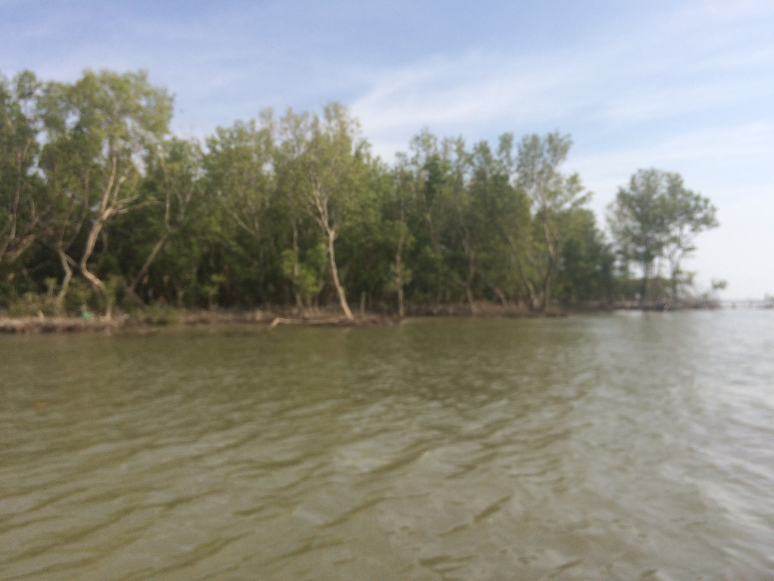
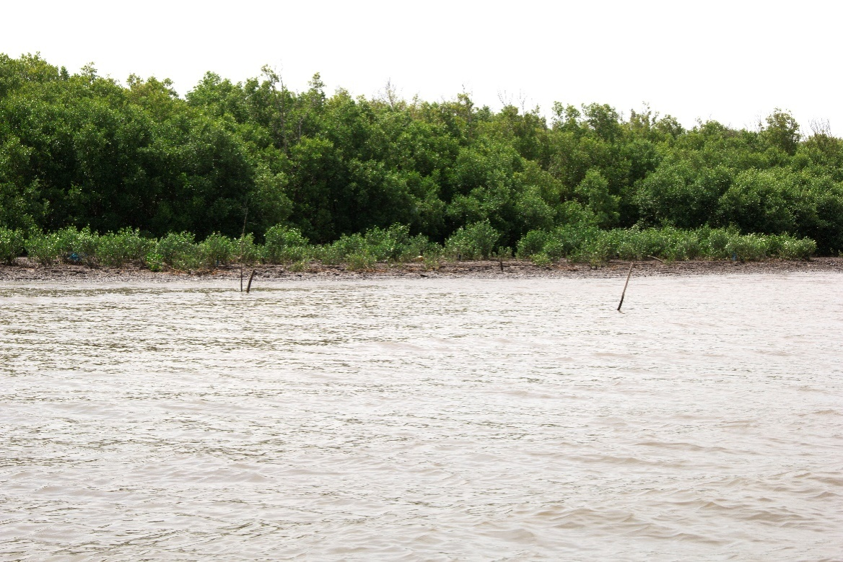
CA MAU Province

Slide 5
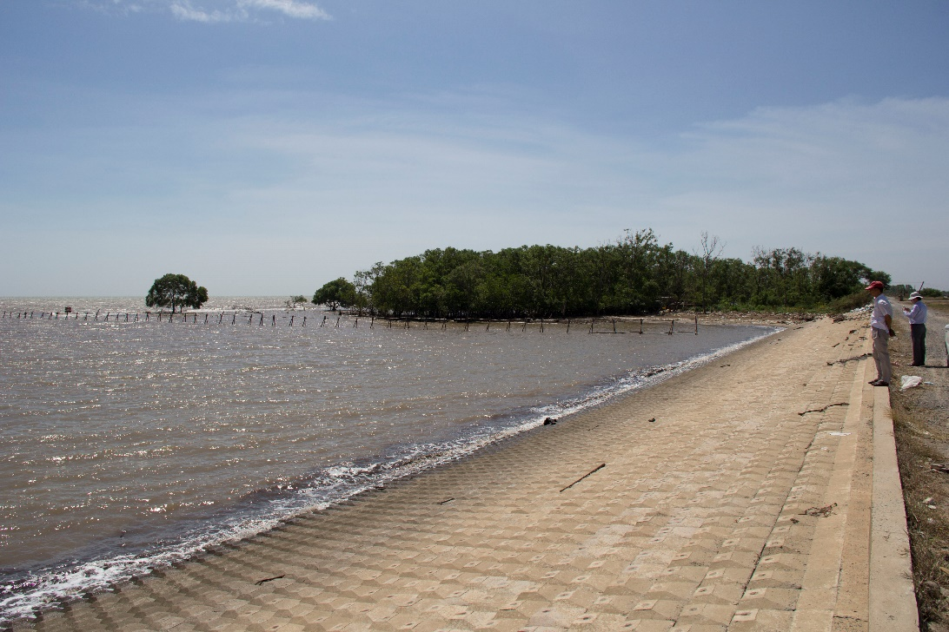
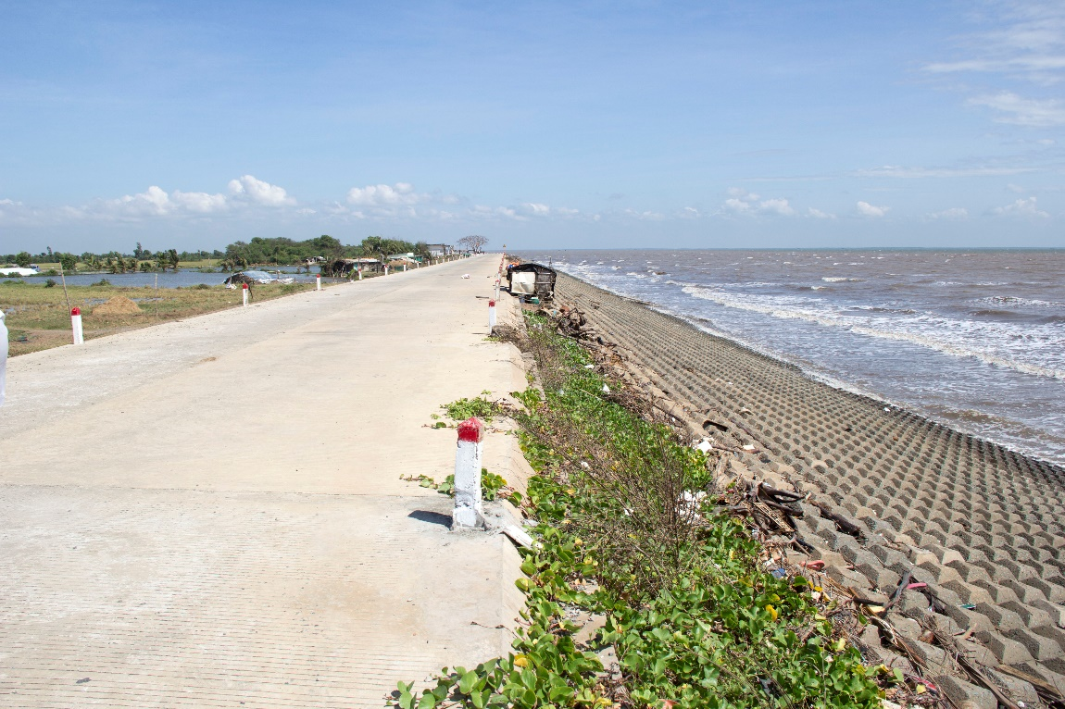
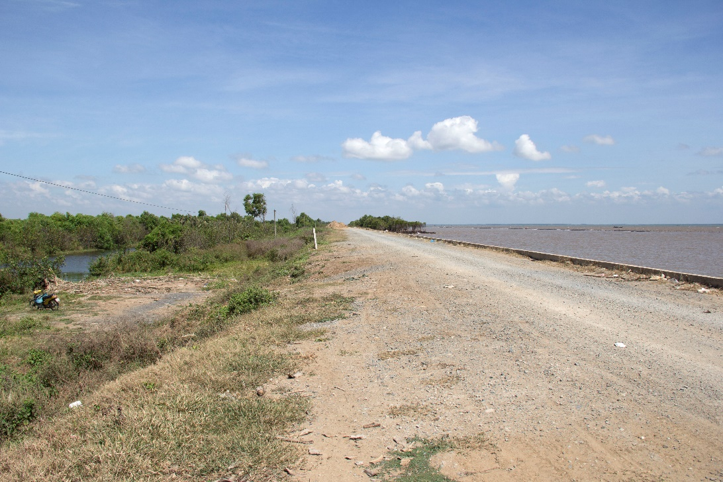
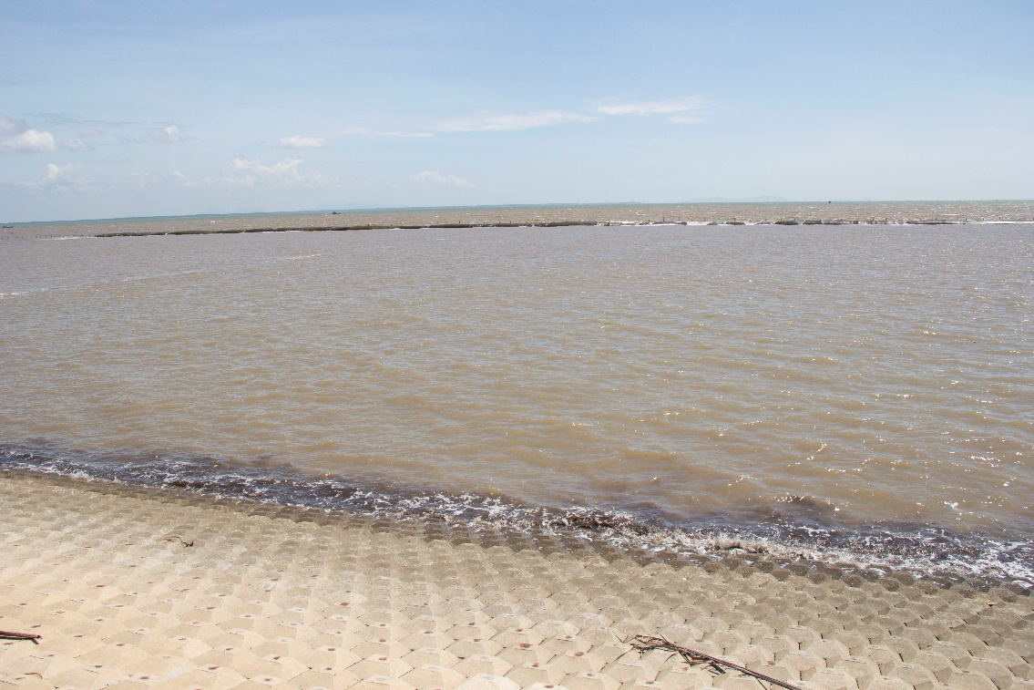
Go Cong, Tien Giang Province

Slide 6
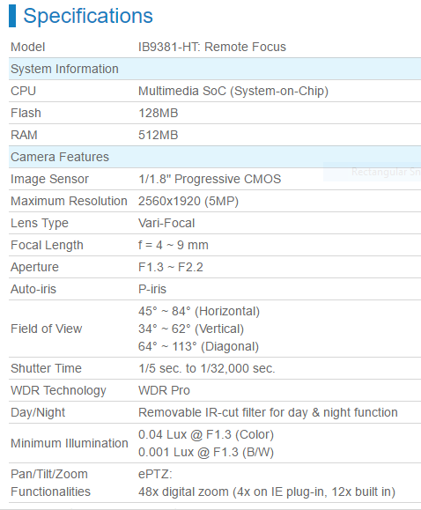
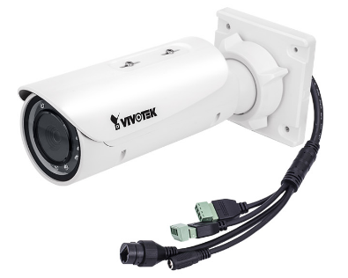
CAMERA CHARACTERISTIC
VIVOTEK CAMERA IB9381-HT: 5MP, Maximum resolution 2560 x 1920

Slide 7
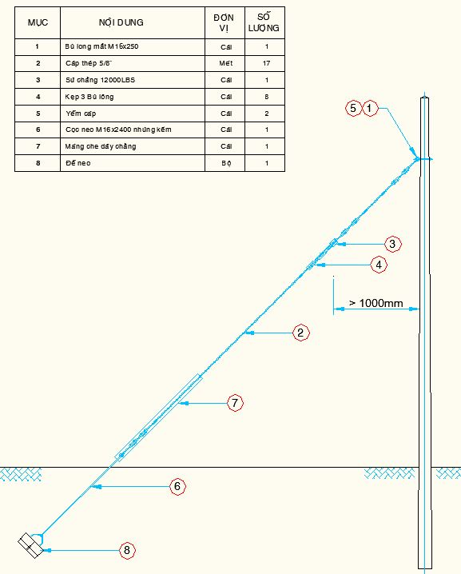
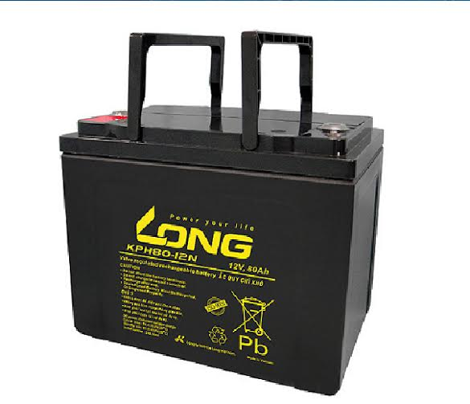
CONFIGURATION OF STATION
Solar panel
Solar charger
Camera
Battery
Data collection:
Go Cong: manual, using USB storage
Ca Mau: via internet

Slide 8
SCHEDULE
No. | Task | Time
1 | Go Cong, Tien Giang Province
 | - Construction | 20/04/2017
 | - Camera installation | 21-23/04/2017
2 | Ca Mau Province
 | - Contractor selection | 24/04/2017
 | - Construction & installation | 08/5/2017
3 | Training camera image analysis technique | 01-07/05/2017

Slide 9
THANK YOU FOR YOUR ATTENTION!
VIỆN KHOA HỌC THỦY LỢI MIỀN NAM
Địa chỉ: 658 Võ Văn Kiệt. Phường 1. Quận 5. TP. Hồ Chí Minh
Điện thoại: (08) 39.23.83.20 – 38.38.09.89 Fax: (08) 39.23.50.28
Email: vkhtlmn@hcm.vnn.vn Website: http://www.siwrr.org.vn
ISO 9001:2008

